Slide 1
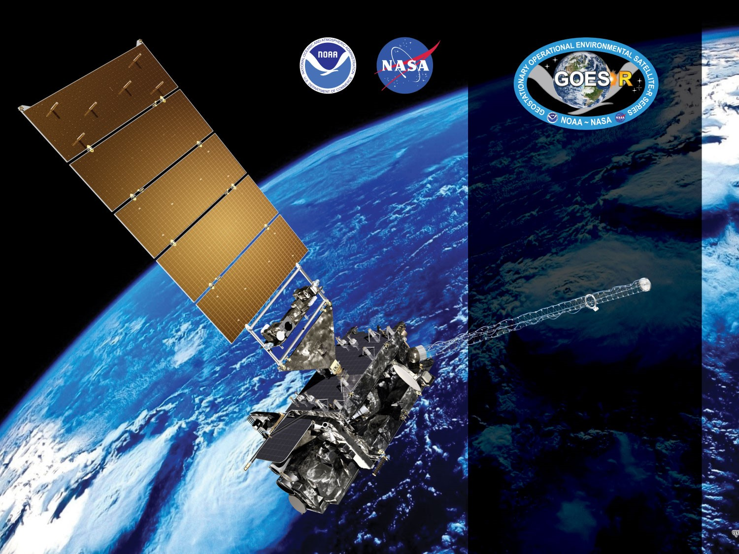
GOES-16 ABI L2+ Rainfall Rate / QPE Provisional PS-PVR
March 30, 2018
GOES-R AWG
Bob Kuligowski*, Yaping Li⁺,
NOAA/NESDIS/STAR*
IMSG Inc. ⁺

Slide 2
Outline
Review of Beta Maturity
Product Quality Evaluation
General approach
Major Issues Remaining
Provisional Maturity Assessment
Path to Full Validation Maturity
Issues and status
Risks
Summary and Recommendations

Slide 3
Review of Beta Maturity
GOES-16 Rainfall Rate / QPE L2 Product Provisional PS-PVR

Slide 4
Product Overview
The GOES-R ABI Rainfall Rate / QPE uses single-image data from five different spectral bands to retrieve estimates of instantaneous rainfall rate at the full IR pixel scale for the entire full disk. These five bands are transformed into 16 predictors, 8 of which are nonlinear transformations of the first 8:
T_{6.2} - 174 K | T_{8.5} - T_{7.34} + 30 K
S = 0.568*(T_{min,11.2}-217 K) + 25 K | T_{11.2} - T_{7.34} + 20 K
T_{avg,11.2} - T_{min,11.2} – (S – 25 K) + 85 K | T_{8.5} - T_{11.2} + 30 K
T_{7.34} - T_{6.19} + 30 K | T_{11.2} - T_{12.3} + 20 K
Separate pairs of predictors from this set are used for rain / no rain discrimination (linear only) and rain rate retrieval (both).
NOTE: This product has no precedents; i.e., it uses only L1b radiances as input.

Slide 5
Product Overview
Separate rain / no rain and rain rate retrieval equations were calibrated against microwave rain rates (CPC MWCOMB). The algorithm was designed to allow real-time updating of the calibration coefficients, but the operational code has a fixed set.
Separate calibration equations were developed for each 30° latitude band and each of 3 different cloud types:
Type 1 (“water cloud”): T_{7.34}<T_{11.2} and T_{8.5}-T_{11.2}<-0.3
Type 2 (“ice cloud”): T_{7.34}<T_{11.2} and T_{8.5}-T_{11.2}≥-0.3
Type 3 (“cold-top convective cloud”): T_{7.34}≥T_{11.2}
The resulting rain rates are then adjusted to match the distribution of the calibration MW rain rates using LUTs based on PDF matching of the initial output rain rates with MWCOMB.

Slide 6
Product Overview: Specifications
Rainfall Rate / QPE | Specification
Geographic Coverage | Full Disk
Measurement Range | 0-100 mm/h
Measurement Accuracy | 6 mm/h at a rate of 10 mm/h with higher values at higher rates
Refresh Rate | 15 min (Mode 3 and Mode 4)
Measurement Precision | 9 mm/h at a rate of 10 mm/h with higher values at higher rates

Slide 7
Review: Time-Line/Context
19 Nov 2016 GOES-R Launch
29 Nov 2016 GEO orbit attained (became GOES-16)
03 Jan 2017 ABI aperture door open/1st light for visible/near-infrared channels
Mid Jan 2017: AWG established access to GS L2 products. Qualitative RRQPE L2 product validation begins.
1 March 2018: L1b is Beta validated; quantitative RRQPE L2 product validation begins.
16 May 2017 Conditional PS-PVR Beta
13 September 2017 Full PS-PVR Beta

Slide 8
Beta PLPTs Under Review
PLPT ID | Descriptive Title | % Complete | Results | AWG POC
ABI-FD_QPE01 | Verify Product is generated every 15 min for FD for M3 | 100 | Complete | PRO
ABI-FD_QPE02 | Verify Product is generated every 15 min for FD for M4 | 100 | Complete | PRO
ABI-FD_QPE03 | Assess accuracy and precision of product | 100 | Complete | AWG

Slide 9
Definitions of Metrics for ABI-FD_QPE03
Accuracy=Absolute difference in average rain rate between satellite and validation data
Precision=68th percentile of absolute difference between satellite and validation data
Additional details:
Stats are computed only for pixels with satellite rain rates of 9.5-10.5 mm/h
Computed over all data between 60⁰S and 60⁰N and for satellite zenith angles ≤70⁰
Each satellite pixel is matched with the GV pixel within 15 km that has the closest value

Slide 10
Results of ABI-FD_QPE03
(mm/h) | Spec | Vs. MRMS | Vs. DPR
Accuracy | 6.00 | 7.47 | 7.93
Precision | 9.00 | 9.58 | 9.85
Computed for a total of 3,942,200 pixels (MRMS) and 40,913 pixels (DPR) with corresponding satellite rain rates of 9.5-10.5 mm/h for 1 March - 2 May 2017. For DPR, only pixels with latitude ≤ 60° and satellite zenith angle ≤70 ° were considered as per stated requirements.
FAILED

Slide 11
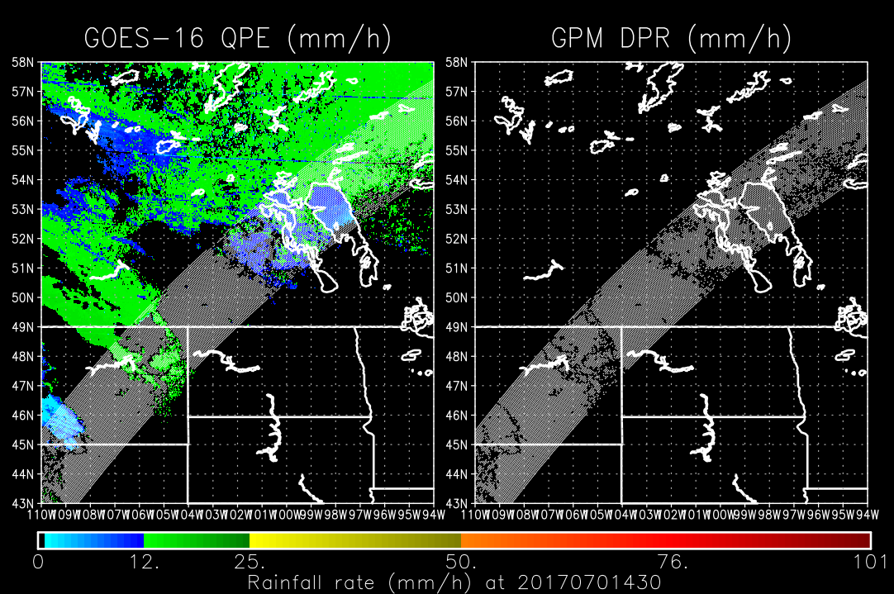
Performance Issue Identified
False rain in high latitudes during cool season due to WV band differences between SEVIRI and ABI (and limb cooling)
Some evidence of this (due to limb cooling) in in SEVIRI during v5 algorithm evaluation over Western Europe--did not meet spec when validated against NIMROD radar but met spec comfortably vs. TRMM)
However, magnitude is much greater for GOES-16 than for the original SEVIRI v5 validation vs. NIMROD—apparent cause is difference in WV passbands between SEVIRI and ABI

Slide 12
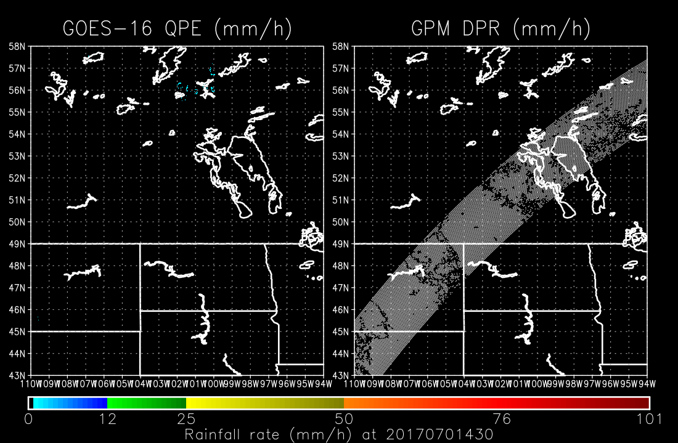
Performance Issue Addressed
Developed and tested a new set of calibration coefficients that were based on the GOES-16 ABI WV bands
Largely eliminated high-latitude false rainfall.
Original Coefficients
New Coefficients
con.V5y.Q3.ctl

Slide 13
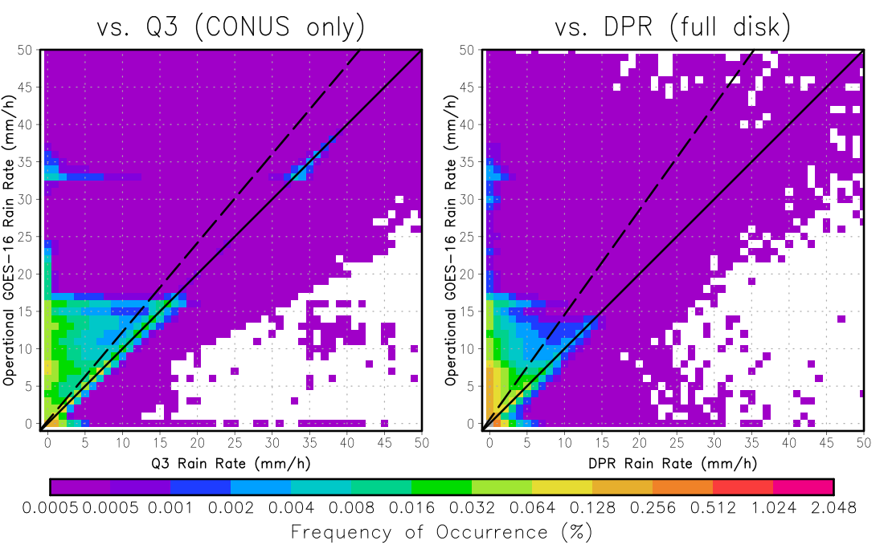
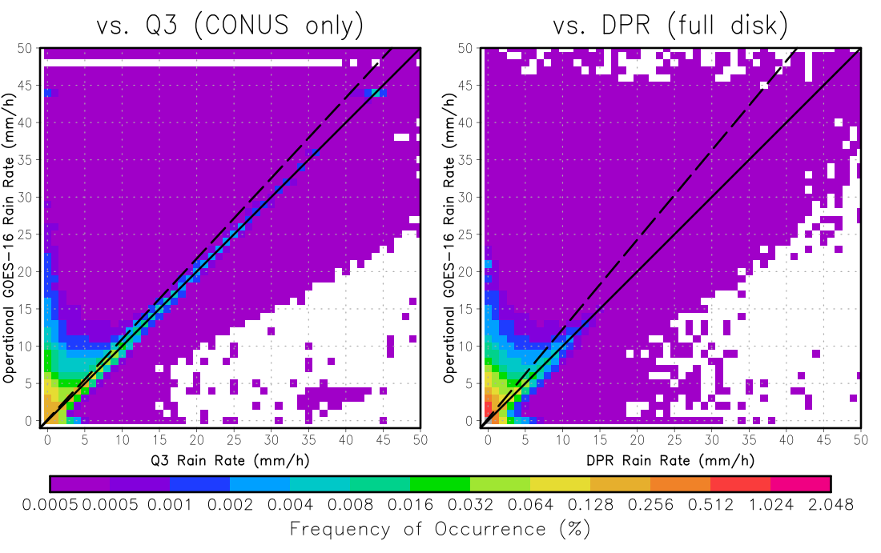
Validation Results for Updated Coefficients
Original Coefficients
Updated Coefficients
Computed for 1 March – 30 August 2017.

Slide 14
Validation Results for Updated Coefficients
(mm/h) | Spec | Vs. MRMS |  | Vs. DPR
 |  | Old | New | Old | New
Accuracy | 6.00 | 6.53 | 3.87 | 7.60 | 5.11
Precision | 9.00 | 9.54 | 7.85 | 9.71 | 8.48
Computed for pixels with retrieved rain rates of 9.5-10.5 mm/h for 1 March – 30 August 2017. For DPR, only pixels with latitude ≤ 60° and satellite zenith angle ≤70 ° were considered as per stated requirements.
Passed

Slide 15
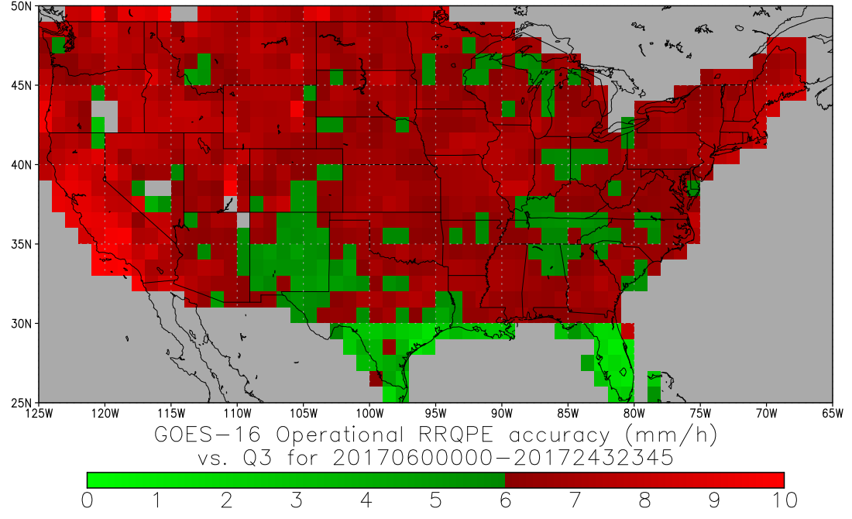
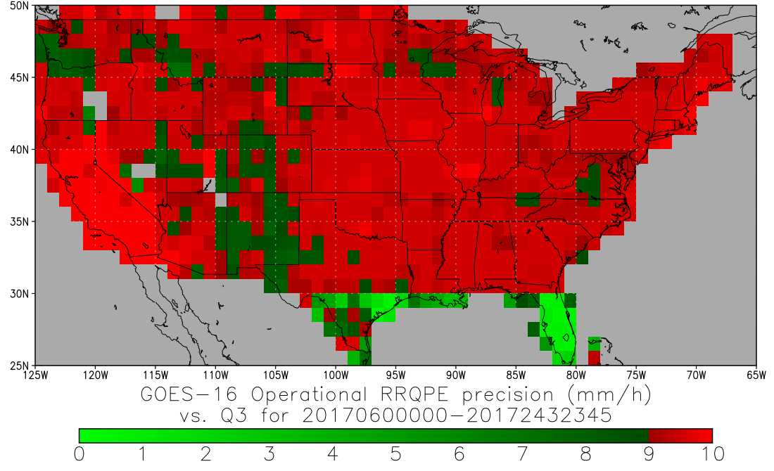
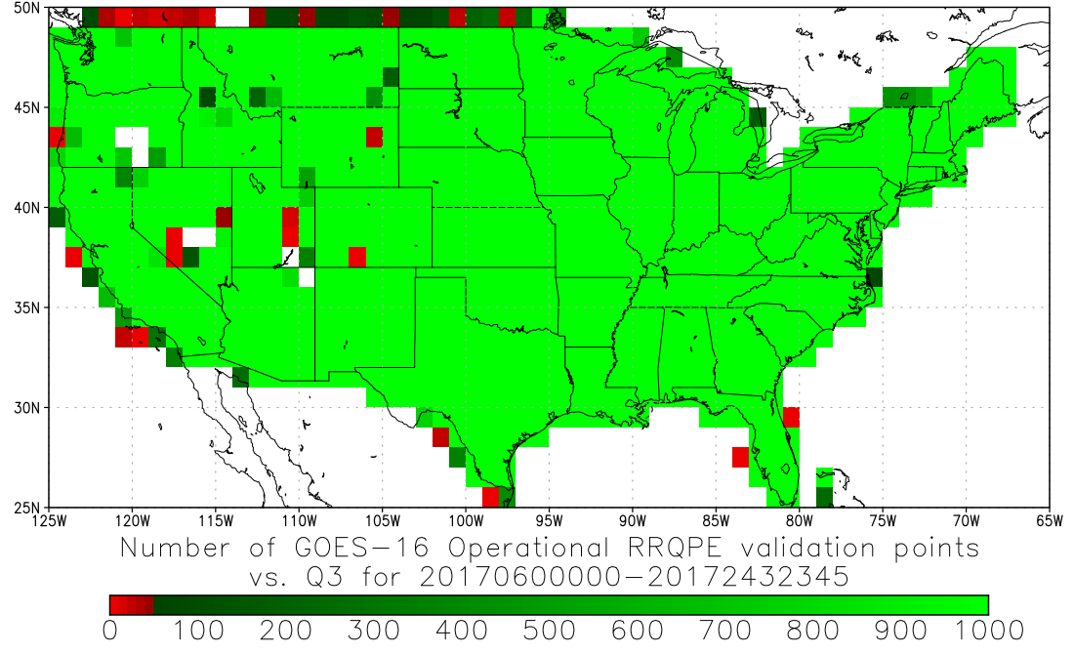
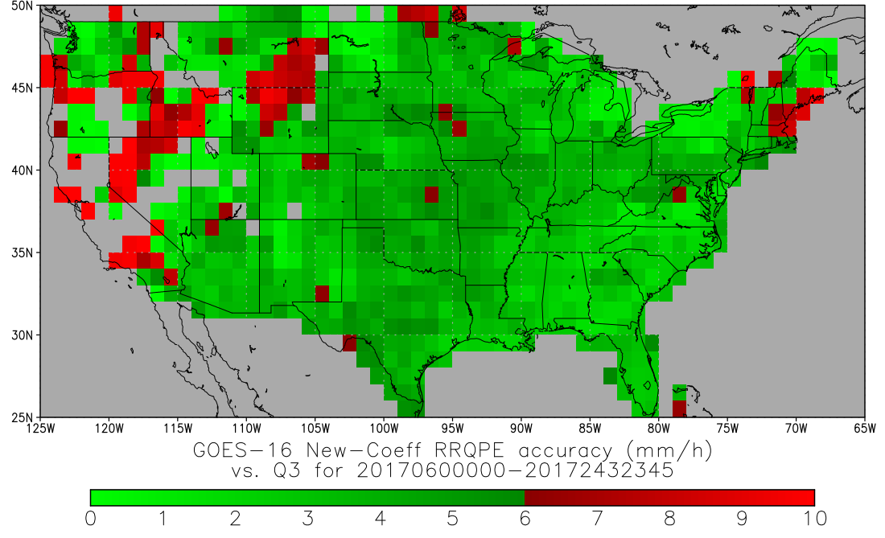
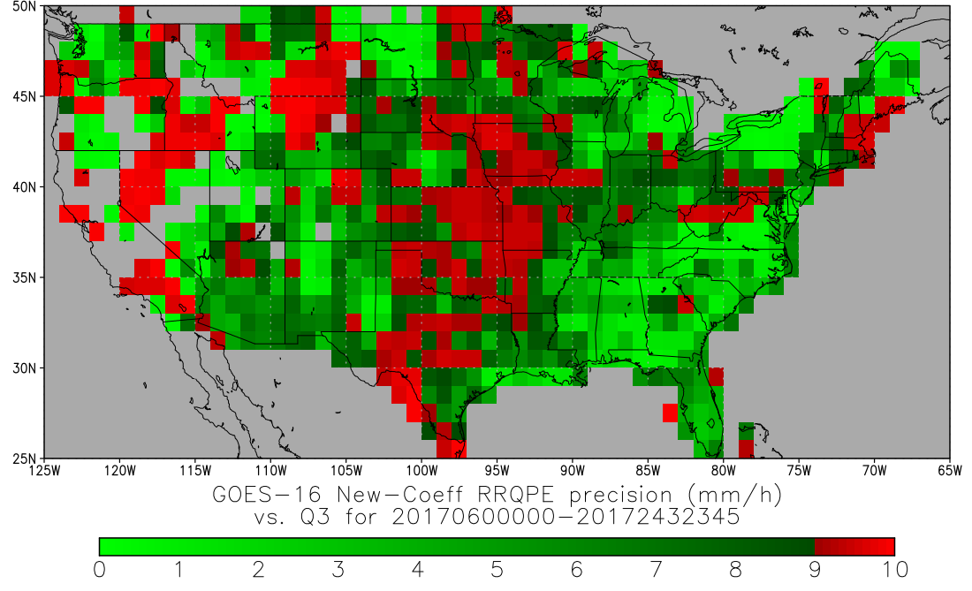
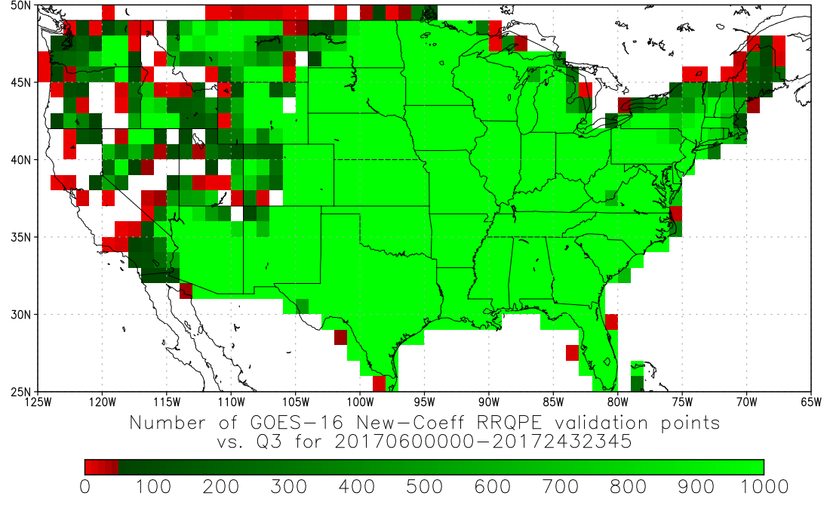
Validation Results for Updated Coefficients
Accuracy
Precision
Number of Data Points
Original Coefficients
New Coefficients
Computed for pixels with retrieved rain rates of 9.5-10.5 mm/h for 1 March – 30 August 2017.

Slide 16
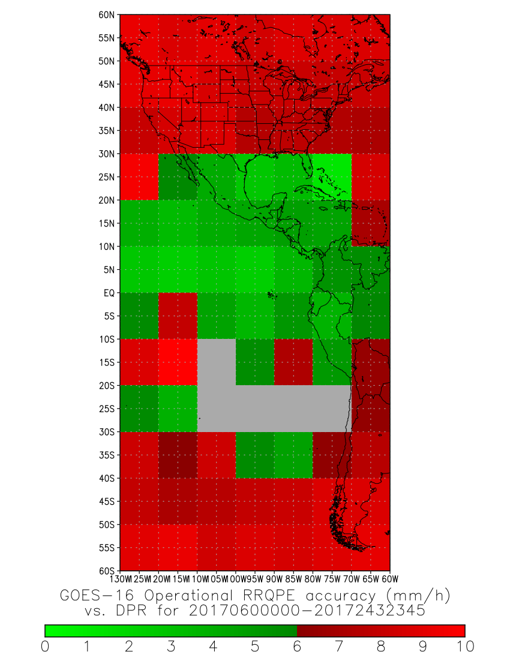
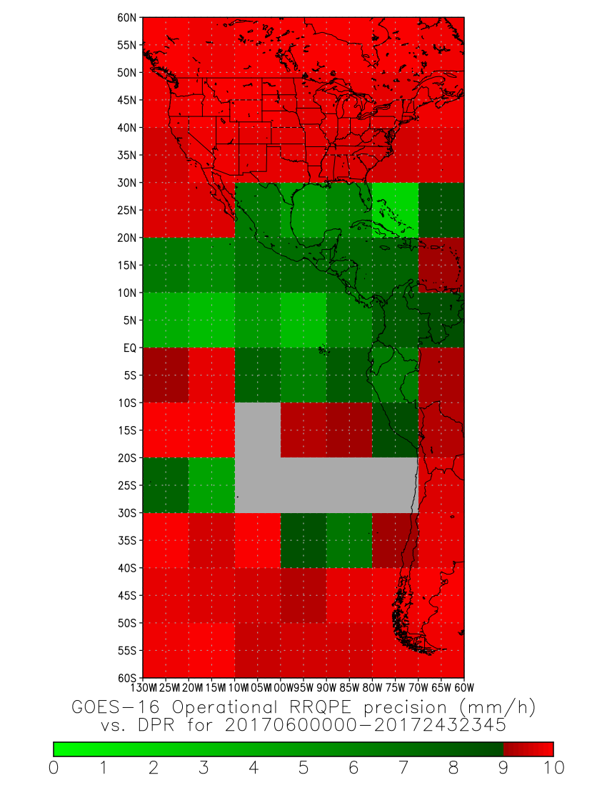
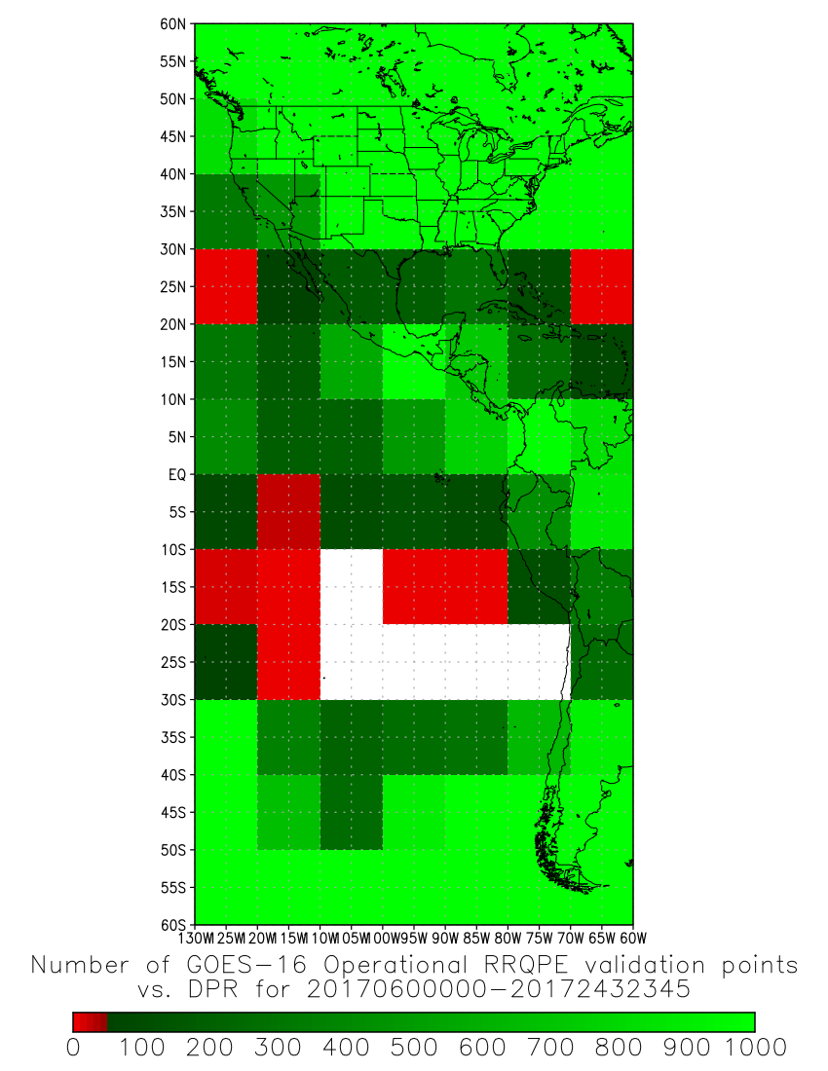
Validation Results for Updated Coefficients
Accuracy
Precision
Number of Data Points
Original Coefficients
Computed for pixels with retrieved rain rates of 9.5-10.5 mm/h for 1 March – 30 August 2017.

Slide 17
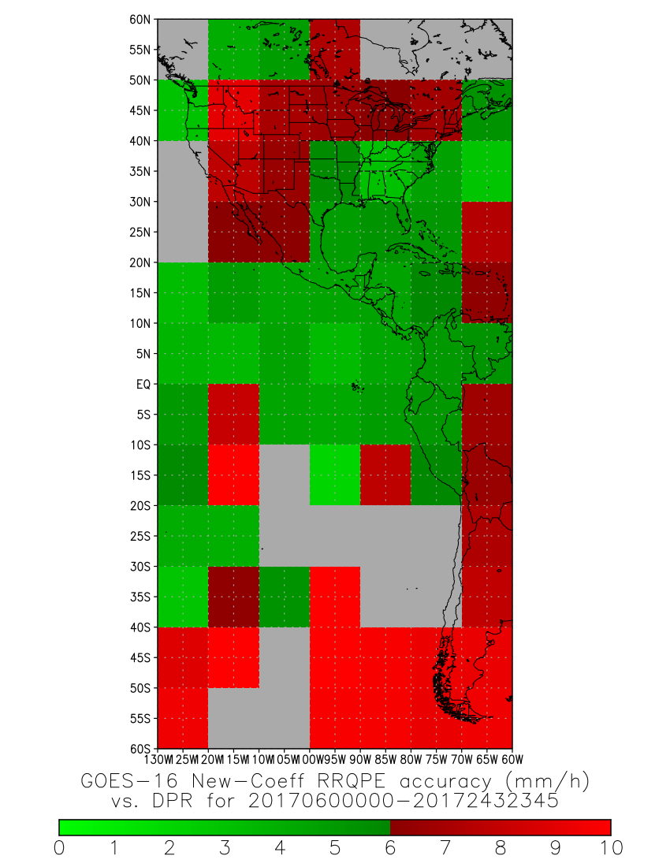
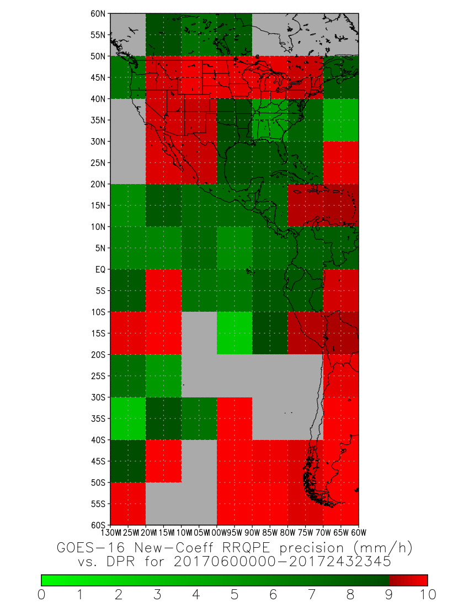
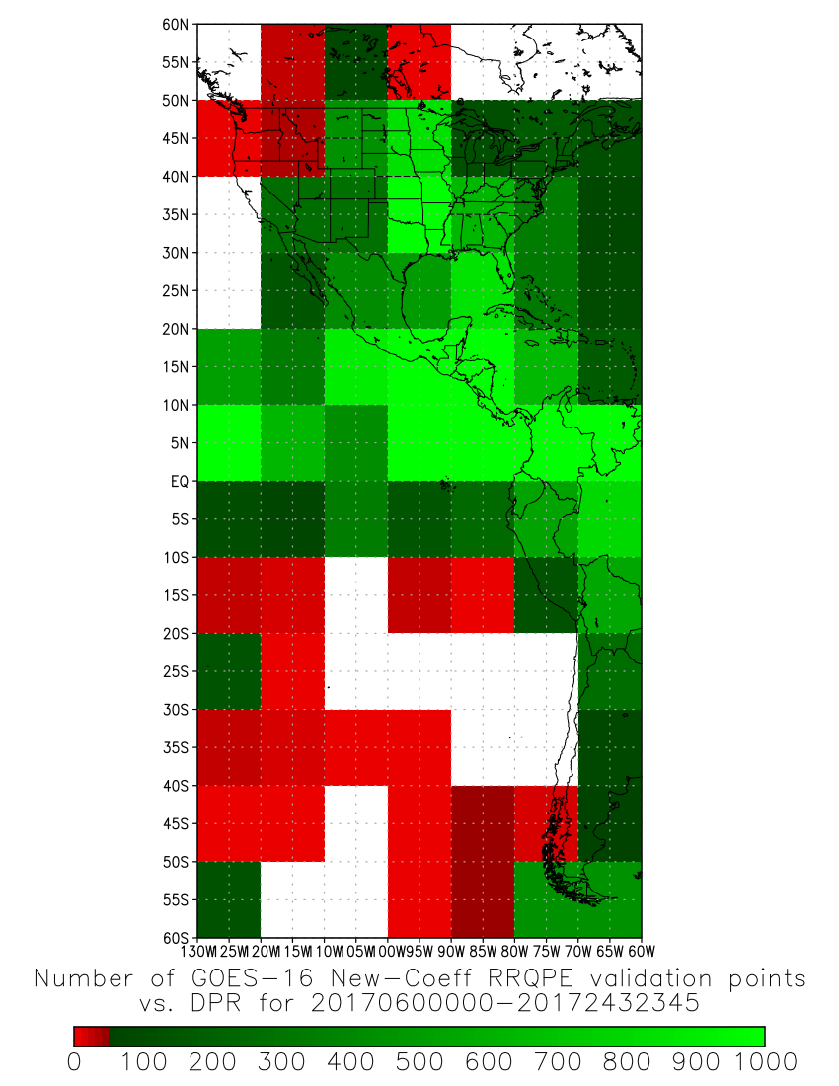
Validation Results for Updated Coefficients
Accuracy
Precision
Number of Data Points
New Coefficients
Computed for pixels with retrieved rain rates of 9.5-10.5 mm/h for 1 March – 30 August 2017.

Slide 18
Issue Needing Resolution for Full Beta Maturity
Title | Description | Impact | Mitigation | Status
ADR412 | The current static calibration file is producing significant amounts of false rainfall that has been traced back to the differences in the WV passbands between SEVIRI (on which the calibration was initially developed) and ABI. | Significant amounts of false precip in cold clear air. | PR05.02 | Installed
16 May 2017 Conditional PS-PVR Beta
13 September 2017 PR05.02 installed
13 September 2017 Full PS-PVR Beta

Slide 19
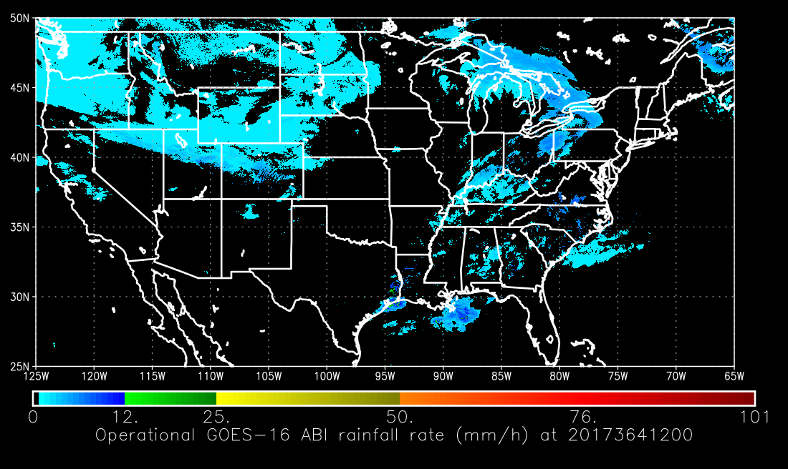
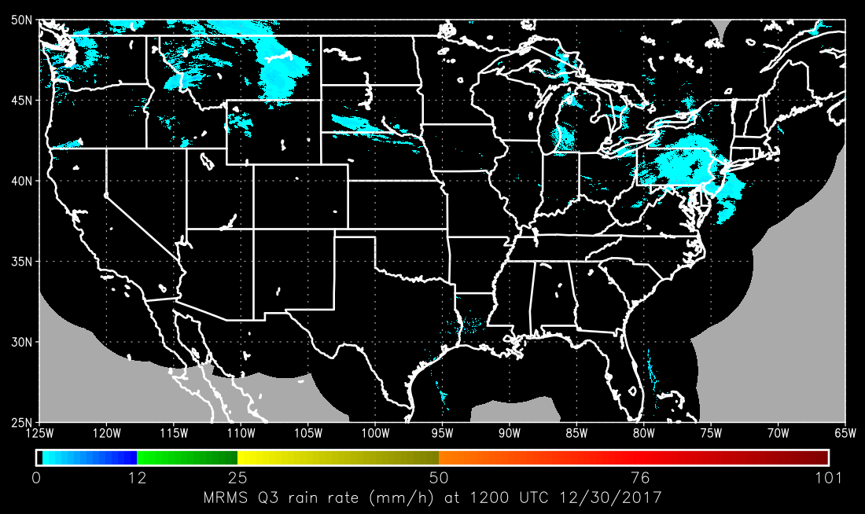
Another Performance Issue
The false rain returned with a vengeance during the severe cold air outbreak in late December
It was discovered that certain channel combinations (T_{11.2}-T_{7.34} and T_{8.5}-T_{7.34}) that were very skillful for rain-no rain detection (identifying overshooting tops) were also susceptible to mistaking extremely cold air for rainfall (low-level inversions give the same signal)

Slide 20
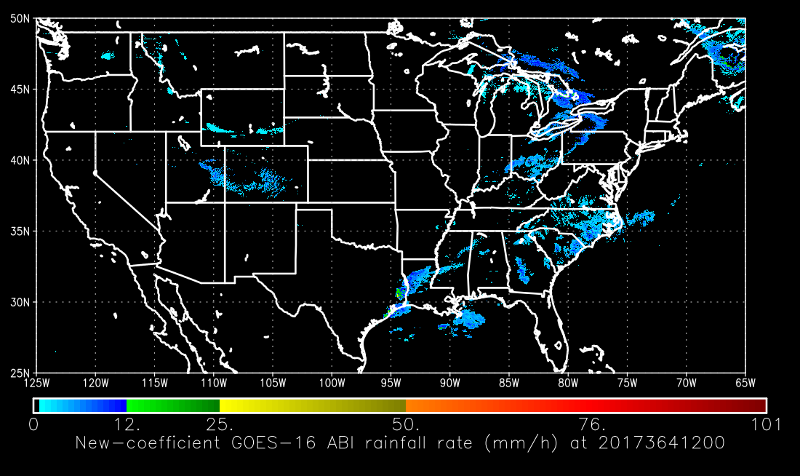
Another Performance Issue
The false rain returned with a vengeance during the severe cold air outbreak in late December
Removing these channel combinations from the predictor set resolved the problem
However, it also degraded performance in some other instances since some ability to distinguish overshooting tops from cirrus was lost

Slide 21
Issues Needing Resolution for Provisional Maturity
Title | Description | Impact | Mitigation | Status
ADR559 | The cold air outbreak over the northeastern US was far colder than anything in the previous test dataset, and the calibration coefficient fix that worked late last winter is producing false rain signatures in this cold air. | Significant amounts of false rainfall in cold clear air. | PR06.08 | Installed
30 Nov–11 Dec 2017 Spacecraft Drift to East Slot
25 January 2018 PR06.08 installed
30 March 2018 Provisional PS-PVR

Slide 22
Product quality evaluation
GOES-16 Rainfall Rate / QPE L2 Product Provisional PS-PVR

Slide 23
Provisional PLPT
PLPT ID | Descriptive Title | % Complete | Results | AWG POC
ABI-FD_QPE04 | Assess accuracy and precision of product | 100 | Complete | AWG

Slide 24
Top Level Evaluation
 | Past Performance (at Beta PS-PVR) | Current Status | Future Outlook
Quantitative Performance: (Accuracy, Precision) | Conditionally passed for 2 months’ data; passed after coefficient updates Accuracy and precision specs not met on 2 months’ data before coefficient updates but met on 6 months’ data after coefficient updates Identified Issues: Calibration coefficients based on SEVIRI were not appropriate for ABI when WV passbands were involved; result was widespread heavy rainfall in cold air | A cold air outbreak in December revealed that some predictors using the difference between the IR window and WV bands were mistaking surface inversions for rainfall, resulting in widespread light rain in very cold air. A second set of emergency coefficient updates in January (prior to the pre-launch code freeze) largely resolved this issue. Accuracy and precision specs are met for 1 year of (largely) reprocessed data over the CONUS, though not at every point in the CONUS. Spec is not met when the rest of the FD is included. | Expect further improvements in the rain rate product with another improved set of calibration coefficients that is more seasonally robust However, all science code improvements are needed to realize full potential

Slide 25
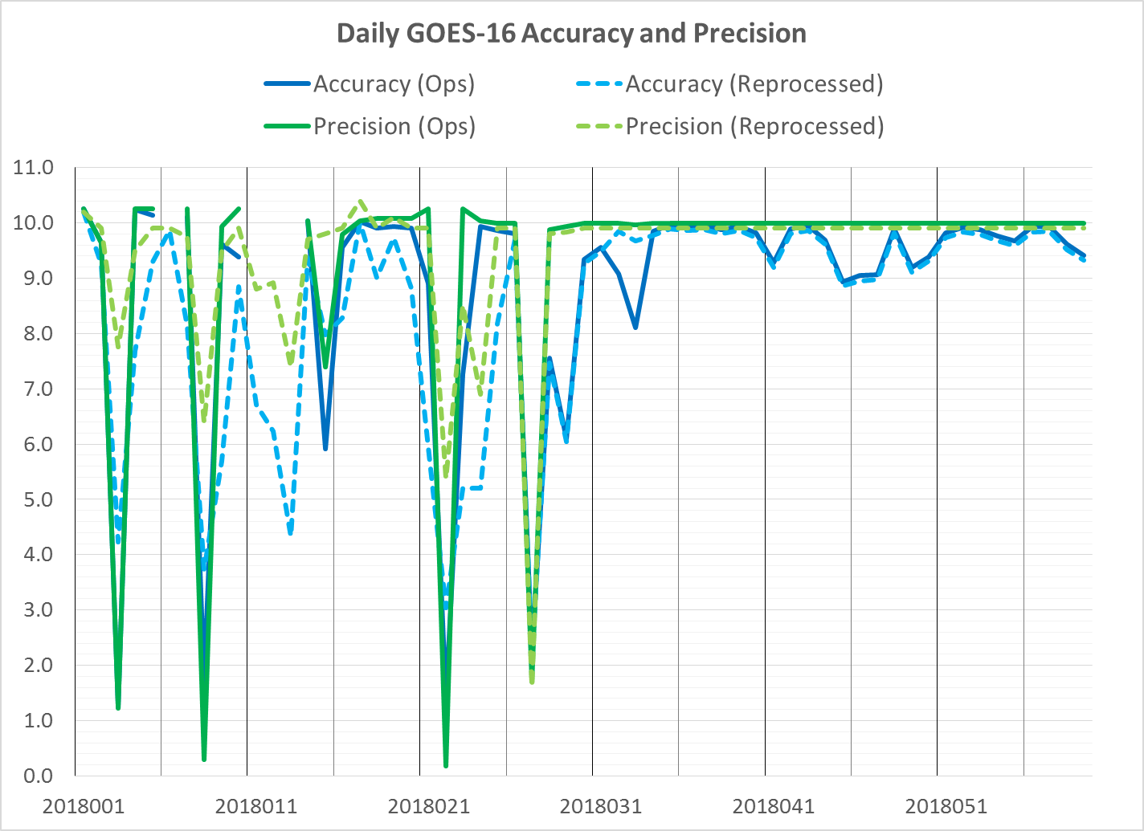
Comparison of GS and STAR Stats
Reprocessed and operational stats converge after OE update on 25 January; differences due mainly to rounding errors.

Slide 26
Results of ABI-FD_QPE04
(mm/h) | Spec | Vs. MRMS |  | Vs. DPR
 |  | Ops | Sci | Ops | Sci
Accuracy | 6.00 | 4.51 | 3.01 | 7.05 | 5.66
Precision | 9.00 | 8.83 | 4.75 | 9.70 | 9.40
Operational rain rates meet spec over the CONUS vs. Q3 but not over the full disk vs. DPR
Science code rain rates meet spec over the CONUS by a wide margin and meet accuracy spec vs. DPR but not precision--due to performance issues during DJF that are still being investigated

Slide 27
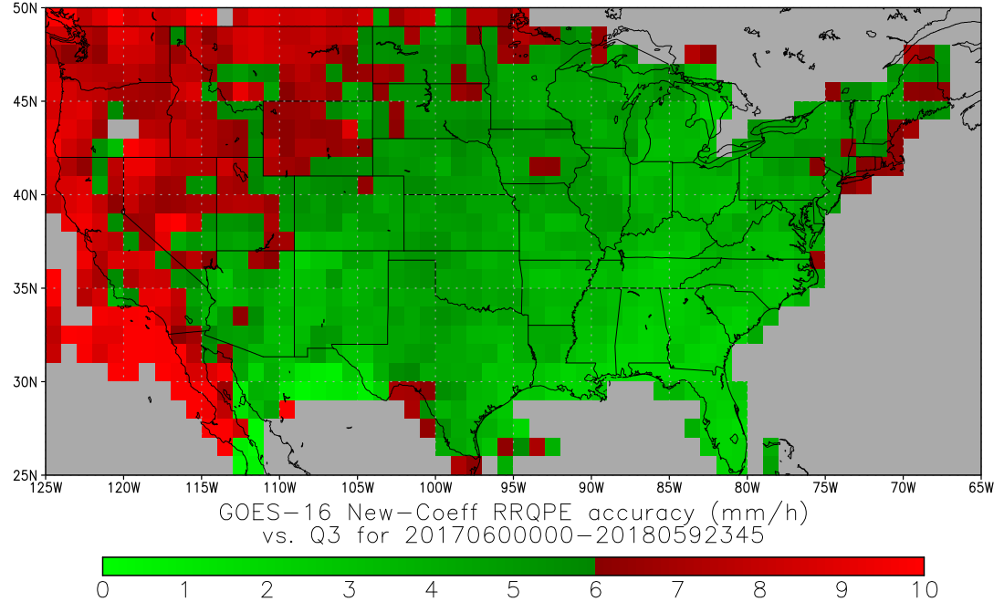
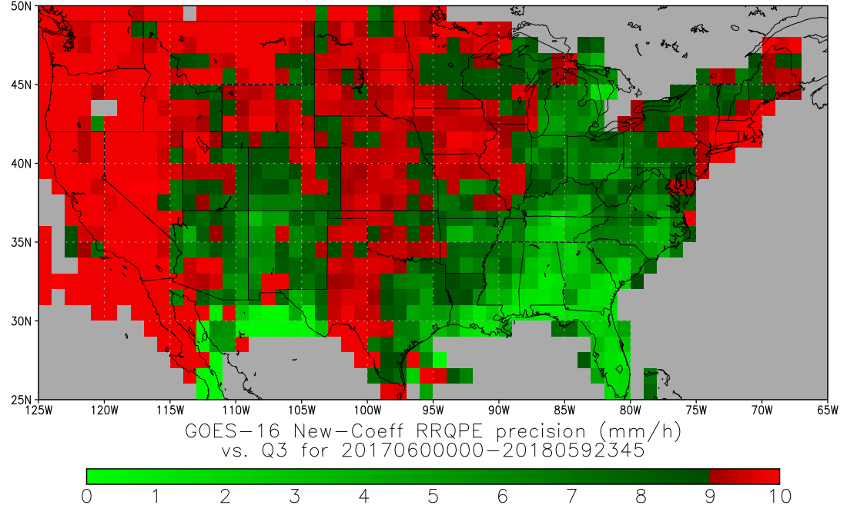
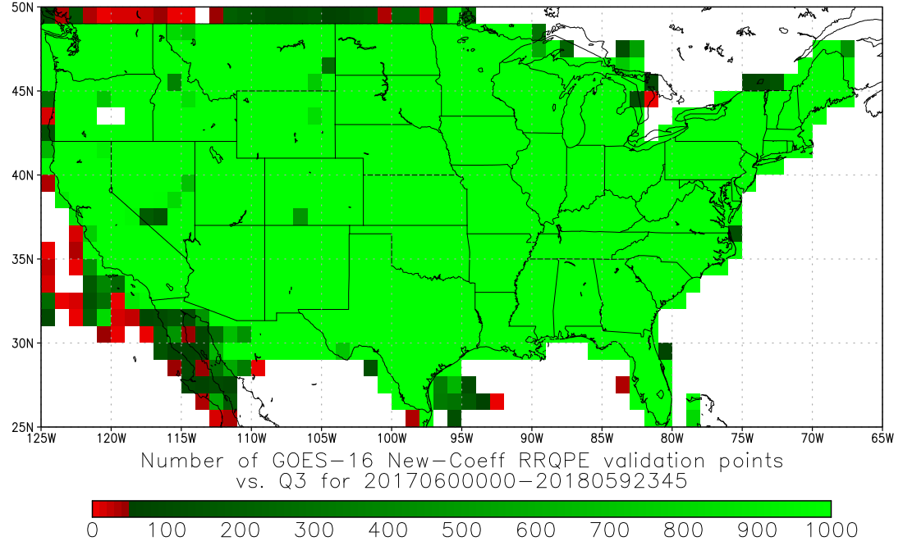
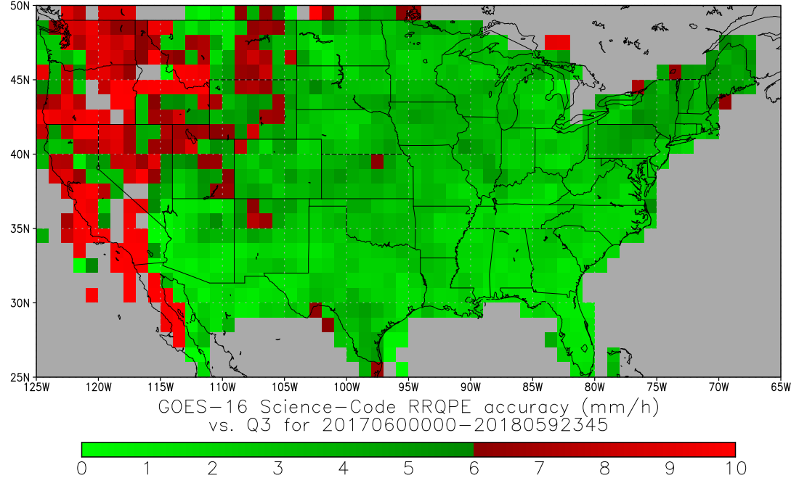
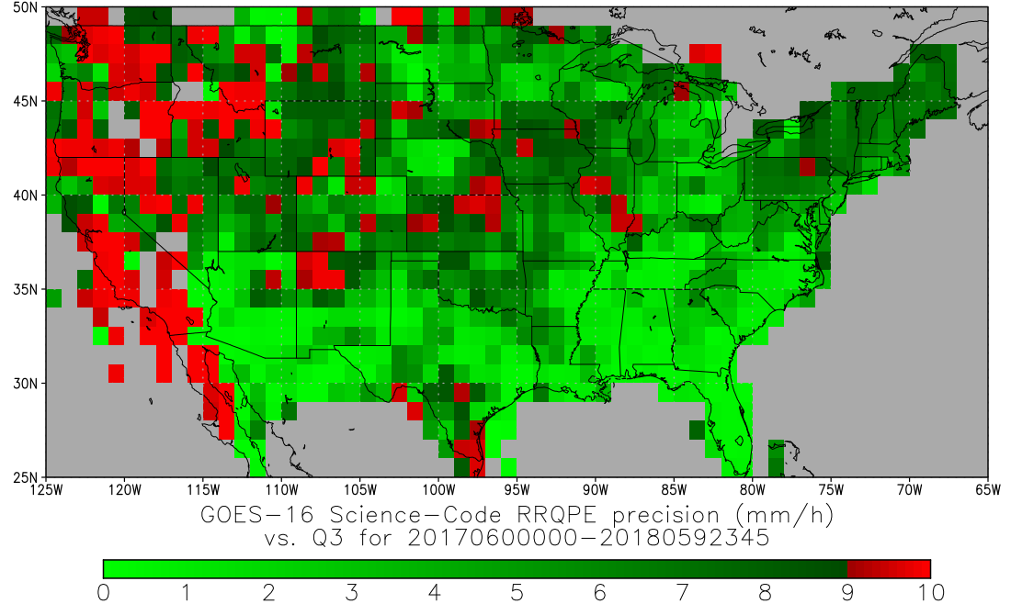
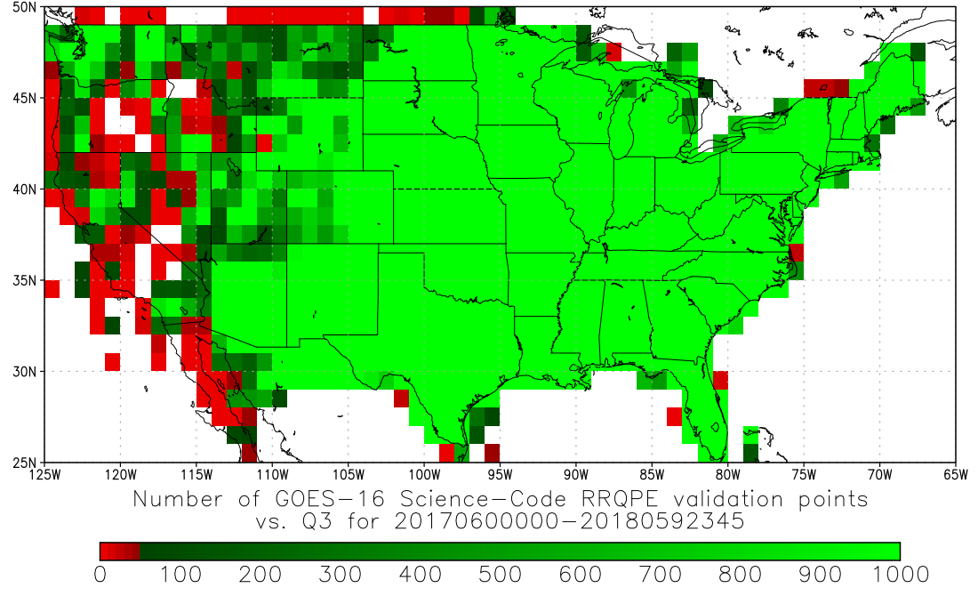
1-Year Validation Results
Accuracy
Precision
Number of Data Points
Operational Algorithm (with January 2018 coefficients)
Science Code
Computed for pixels with retrieved rain rates of 9.5-10.5 mm/h for 1 March 2017 – 28 February 2018.

Slide 28
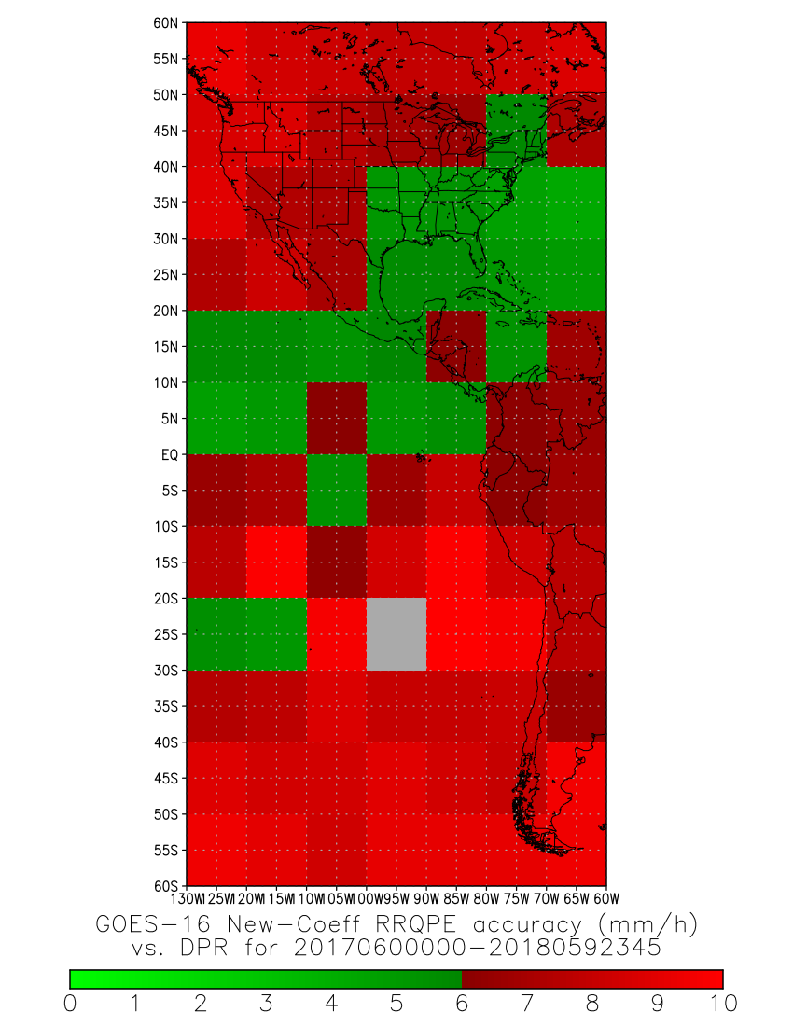
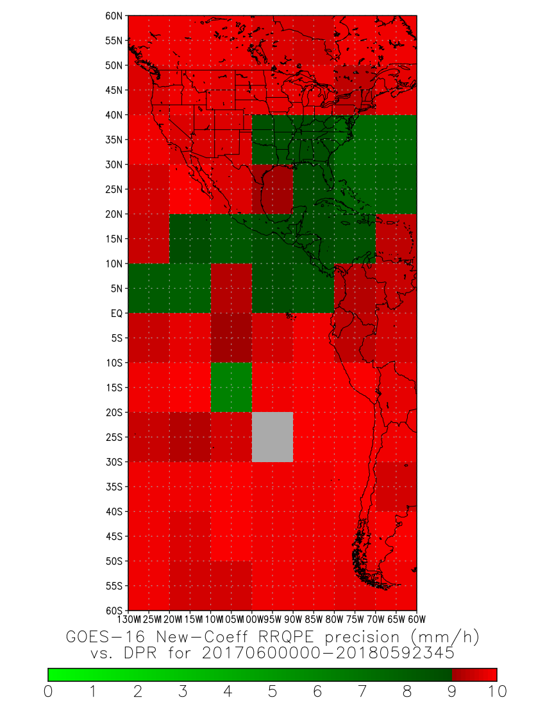
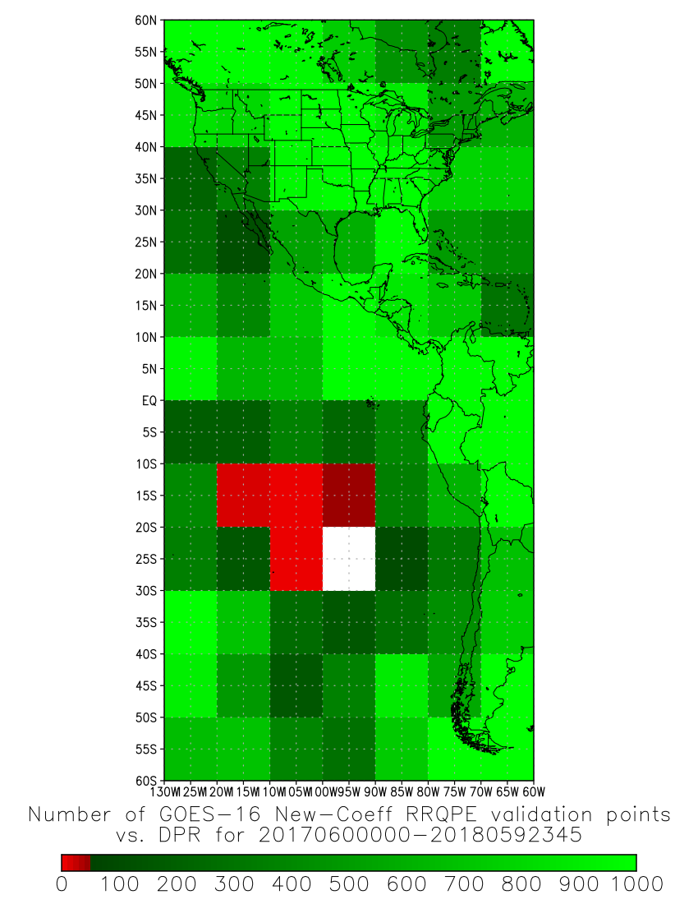
1-Year Validation Results
Accuracy
Precision
Number of Data Points
Operational Code
Computed for pixels with retrieved rain rates of 9.5-10.5 mm/h for 1 March 2017 – 28 February 2018.

Slide 29
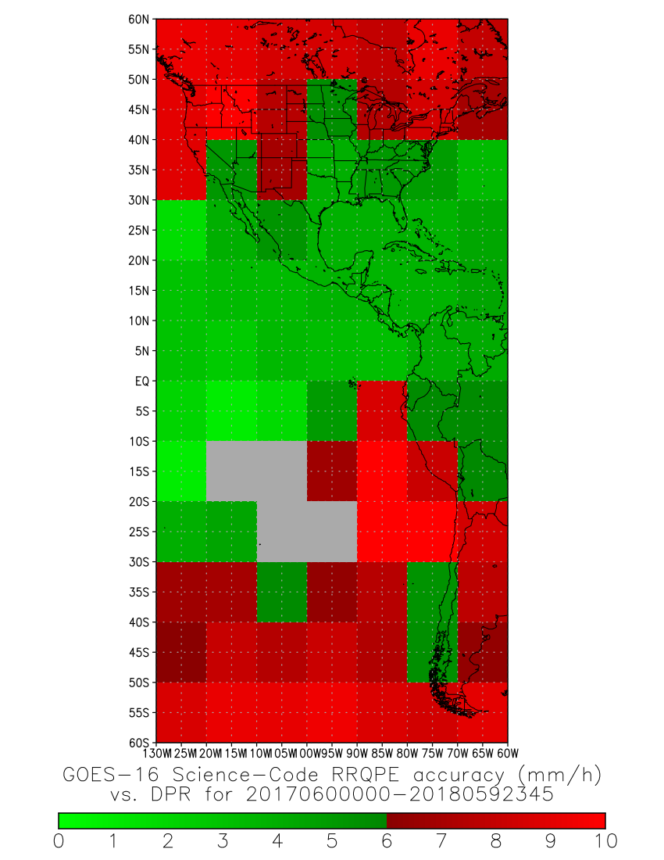
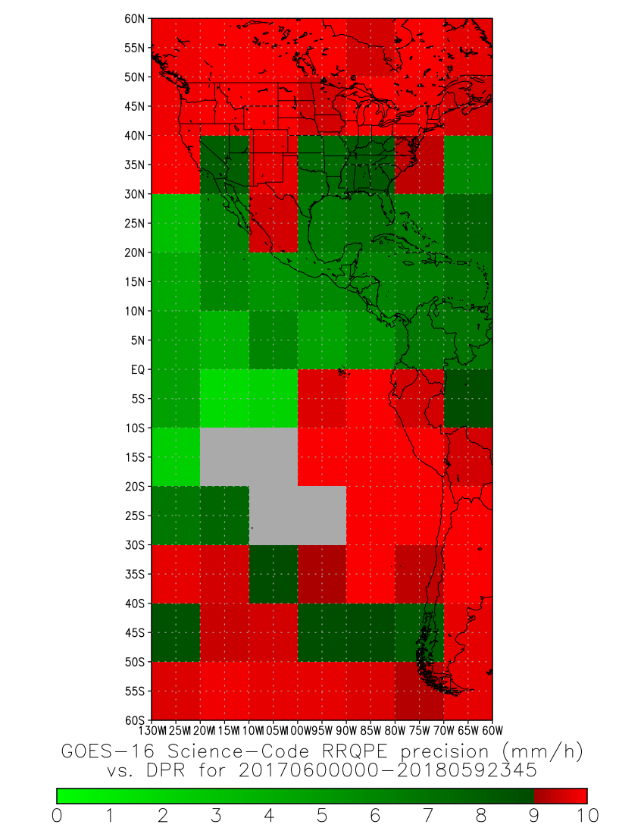
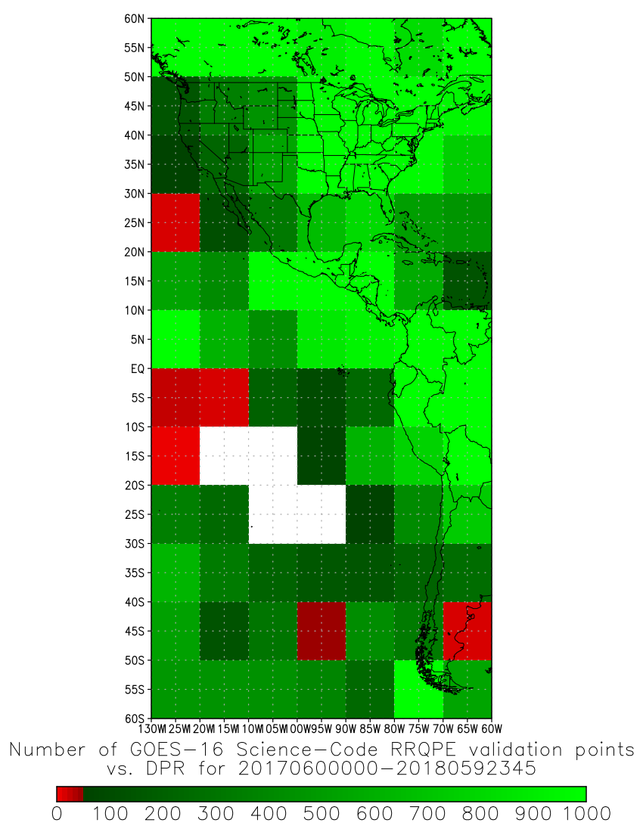
1-Year Validation Results
Accuracy
Precision
Number of Data Points
Science Code
Computed for pixels with retrieved rain rates of 9.5-10.5 mm/h for 1 March 2017 – 28 February 2018.

Slide 30
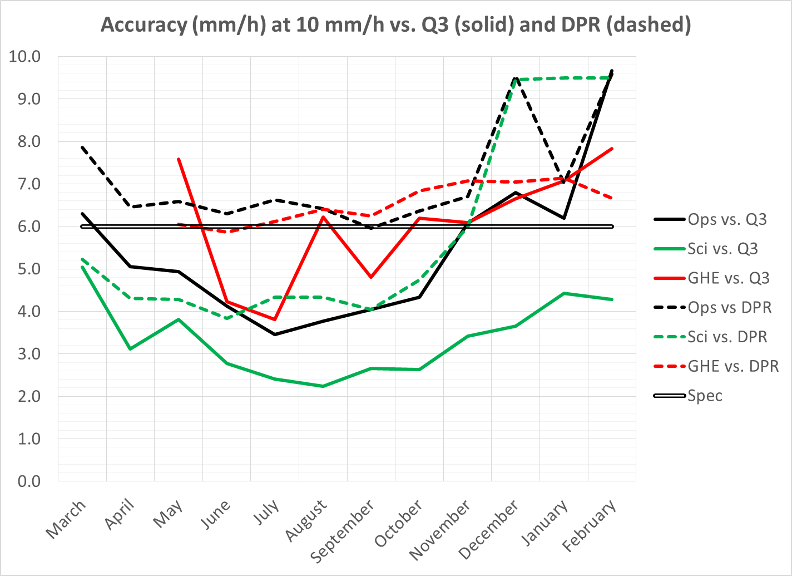
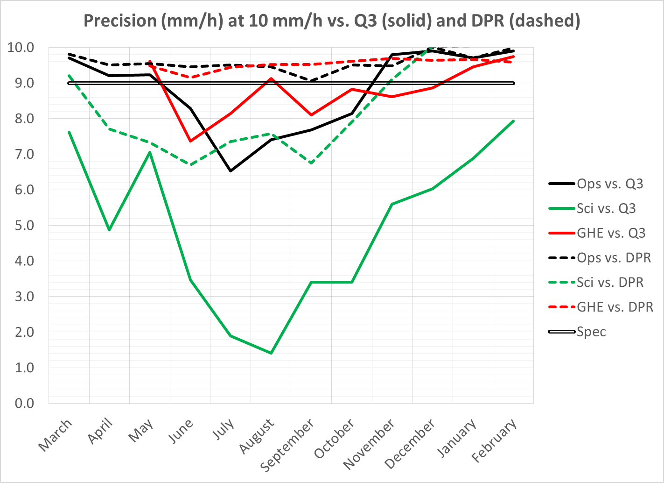
Monthly Validation Results
The operational QPE consistently meets spec and outperforms the GHE in the warm season vs. Q3
The operational QPE and GHE both consistently fail to meet spec vs. DPR
The operational code does very poorly in Dec 2017 and Feb 2018; the cause is still under investigation

Slide 31
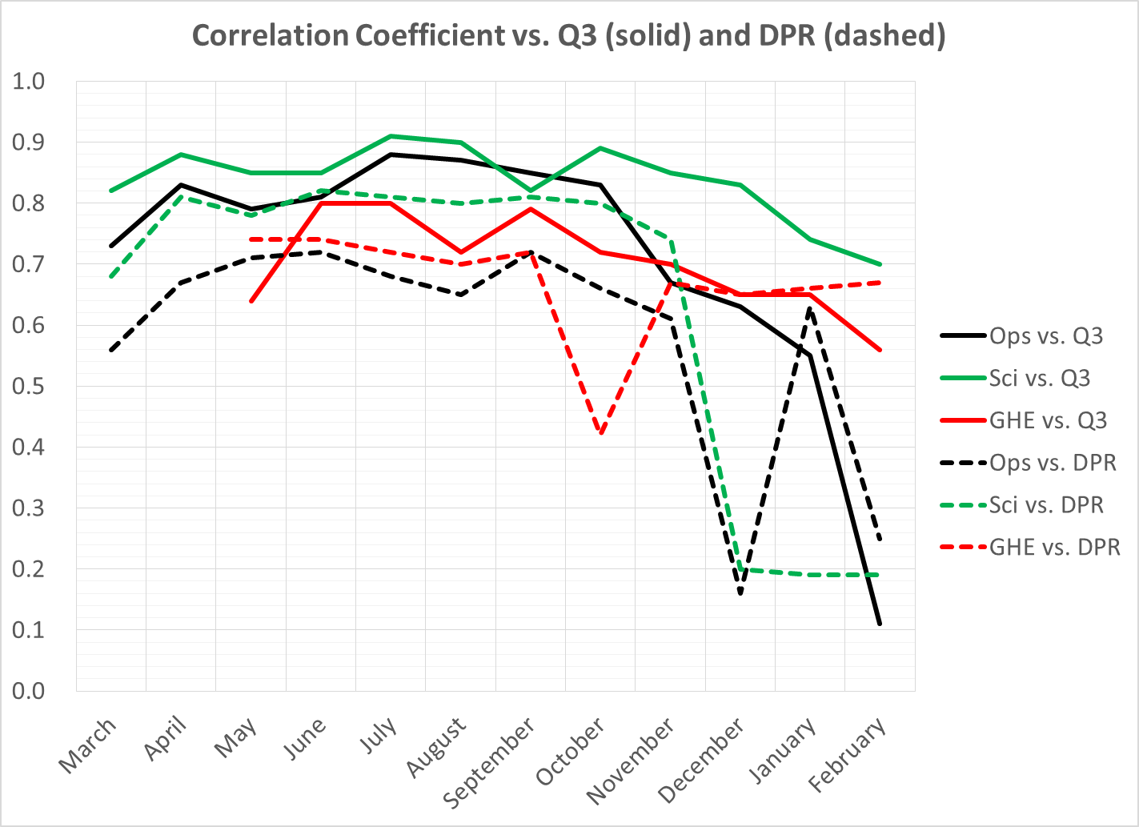
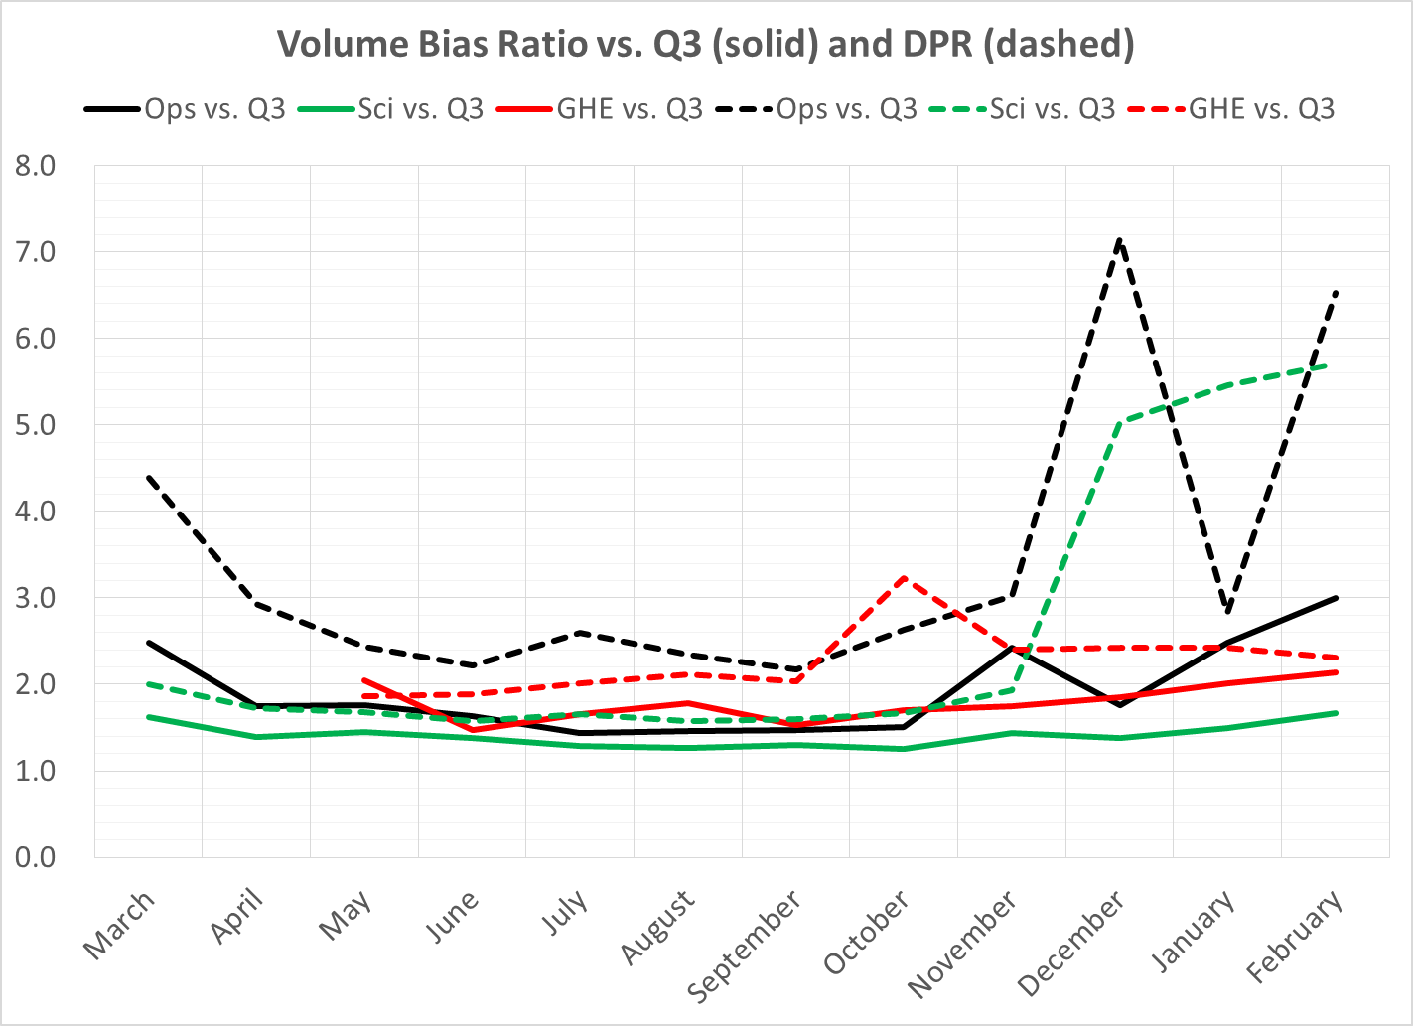
Monthly Validation Results
The operational QPE has higher correlation and less bias than the GHE in the warm season vs. Q3, but not in the cool season
Significant amounts of false-alarm rainfall in the operational QPE in December and February vs. DPR causing high bias; less so vs. Q3

Slide 32
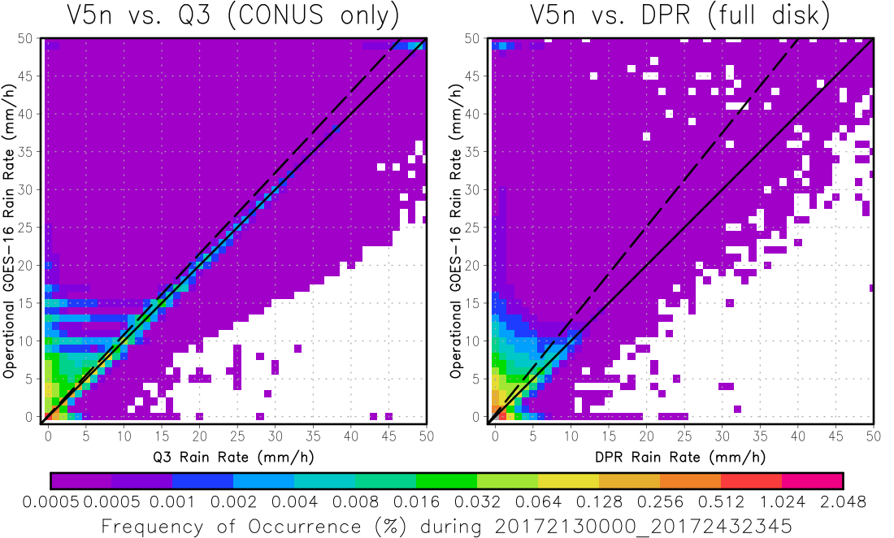
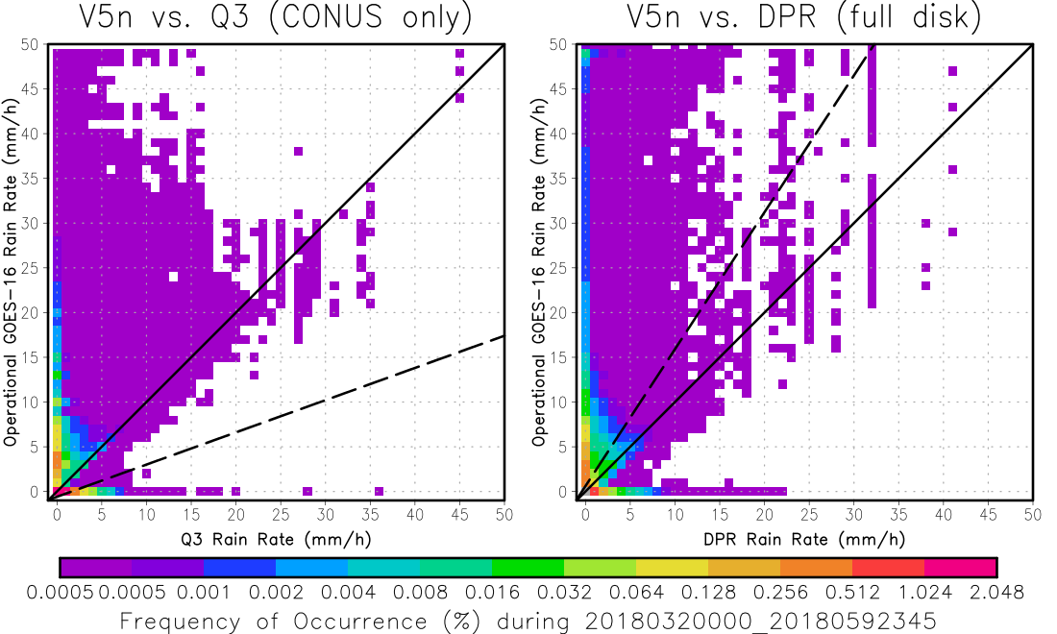
Monthly Validation Results
August 2017
February 2018
The operational QPE tends more toward overestimation than underestimation—not much missed rainfall in the summer
Significant increase in false alarms over CONUS is apparently explained by cool season, but they have been found in the Southern Hemisphere during January also

Slide 33
Top Level Summary of Product Quality
The two coefficient updates significantly improved product quality; however there is still a significant amount of false-alarm rainfall in the cool season
The product meets spec over most of the CONUS, but not all of it, and not at all times
Is meeting spec over the CONUS (as a whole) sufficient, or does it have to meet spec everywhere?

Slide 34
PROVISIONAL MATURITY ASSESSMENT
GOES-16 Rainfall Rate / QPE L2 Product Provisional PS-PVR

Slide 35
Provisional Validation
Preparation Activities | Assessment
Validation activities are ongoing and the general research community is now encouraged to participate. | Validation activities are ongoing.
Severe algorithm anomalies are identified and under analysis. Solutions to anomalies are in development and testing. | Operational and algorithm anomalies have been identified. Critical ones have been resolved (PR05.02 and PR06.08); however, a new ADR will be needed when the cause(s) of the cool-season false alarms have been identified and addressed.
Incremental product improvements may still be occurring. | Incremental product improvements are expected.

Slide 36
Provisional Validation
End State | Assessment
Product performance has been demonstrated through analysis of a small number of independent measurements obtained from select locations, periods, and associated ground truth or field campaign efforts. | This has been demonstrated.
Product analysis is sufficient to communicate product performance to users relative to expectations (Performance Baseline). | This has been communicated in PS-PVR.
Documentation of product performance exists that includes recommended remediation strategies for all anomalies and weaknesses. Any algorithm changes associated with severe anomalies have been documented, implemented, tested, and shared with the user community. | These are documented in this slide deck and will be documented in a separate report and ReadMe file.
Testing has been fully documented. | Testing will be documented in a PLPT Report.
Product is ready for operational use and for use in comprehensive cal/val activities and product optimization. | We concur.

Slide 37
Recommendation
AWG Hydrology Team believes that the GOES-16 Rainfall Rate / QPE product has reached the Provisional Maturity as defined by the GOES-R Program
Technically does not meet spec over the full disk, but NWS users are primarily in the CONUS

Slide 38
Path to full Validation Maturity
GOES-16 Rainfall Rate / QPE L2 Product Provisional PS-PVR

Slide 39
Issues and Status ADRs Needing Resolution for Full VAL
No outstanding ADRs at this time.

Slide 40
Issues and Status Other Actions Needed for Full VAL
Action | Title | Desired Implementation Date into OE
New ADR needed | Rainfall Rate algorithm – Definitively determine the case of the increased false alarm rainfall in DJF and attempt to develop a set of fixed coefficients that can address the issue without significantly compromising performance elsewhere | ≧1 month prior to PS-PVR FULL

Slide 41
Path to Full Validation - PLPTs
PLPT ID | Descriptive Title
ABI-FD_QPE05 | Assess accuracy and precision of Rainfall Rate / QPE product vs. reference / ground truth data.
AWG Hydrology Team will conduct these tests to further evaluate the L2 Rainfall Rate / QPE product quality.
Full test plans and procedures are given in the Rainfall Rate / QPE Readiness, Implementation, and Management Plan (RIMP)

Slide 42
Path to Full Validation – Risks
Risk Name | Description | Impact | Mitigation and Schedule
Operation Stability | IF corrections for known anomalies cannot be implemented in timely manner | THEN the operation will not reach steady state for evaluation | Raise awareness Work with Ground
Update rain rate coefficients | As discussed | Moderate | New WR/ADR needed; ASAP
Little Impact
Moderate Impact
Big Impact

Slide 43
Summary & Recommendations
GOES-16 Rainfall Rate / QPE Product Provisional PS-PVR

Slide 44
Summary
Overall, the Rainfall Rate / QPE product performance is significantly improved since the Beta PS-PVR (June 2017).
Improvements came with PR05.2 and PR06.08
Measured Rainfall Rate / QPE performance against reference data
Accuracy and precision spec met over CONUS when validated vs. MRMS Q3
Accuracy and precision spec not met over much of the FD when validated vs. GPM DPR
Still significant amounts of false alarm rainfall of as yet uncertain origin

Slide 45
Recommendation
AWG Hydrology Team believes that the GOES-16 Rainfall Rate / QPE product has reached the Provisional Maturity as defined by the GOES-R Program
Technically does not meet spec over the full disk, but NWS users are primarily in the CONUS

